Slide 1
DAI PROJECT
Lamport Mutual Exclusion Algorithm

Slide 2
Middle-ware technologies
In this project I wanted to investigate the differences that arise when implementing the Lamport Mutex Algorithm using different middleware technologies
I implemented the Lamport Algorithm in 2 ways:
Via TCP socket (peer-to-peer)
And using the MQTT protocol (pub-sub)

Slide 3
Lamport’s Mutual Exclusion Algorithm
Goal: Ensure exclusive access to a shared resource in a distributed system.
Every process must have a local clock, implemented with Lamport’s timestamps.
Every process must keep an updated requests queue.
The algorithm also assumes there exists a communication channel between process that guarantees the send of messages.
Here’s what I wanted to put to the test

Slide 4
Lamport Clock
In many distributed systems it’s not possible to have a shared global clock, so each process has a local clock to keep a timestamp of when events happened.
The Lamport clock wants to maintain the causal relationship between request and response events.
The Lamport clock is increased by one for every internal event that happens in the process and when a message is received it is updated with the maximum between the local clock and the message clock +1:
LC _local = max(LC_local, LC_msg) + 1

Slide 5
Lamport’s Mutual Exclusion Algorithm
Request:
A process sends a Request message with its timestamp to all other processes.
The request is added to the local queue.
Reply:
Each process sends a Reply message once it has received and acknowledged the request.
Critical Section Entry:
A process enters the critical section when:
Its request is at the top of its queue.
It has received Reply messages from all other processes.
Release:
Upon exiting the critical section, the process sends a Release message to all processes.
The request is removed from all queues.

Slide 6
Lamport’s Mutual Exclusion ALgorithm
The access to the shared resource is guaranteed to happen only one process at a time because each process access the resource only if they are the first in their queue.
The queue is kept updated via the message passings.
The order of the request is kept consistent thanks to the Lamport clocks.
The complexity of the algorithm is 3*(N-1) since for eache access to the resource the process must send to every other process a request, which is replied with an ack from every process; then finally the process send a release message to all processes.
High message load for each resource access.
Finally the algorithm is susceptible of failures, if a process doesn’t respond, everything breaks.

Slide 7
Middleware Implementations
As said before the algorithm requires a stable communication channel between all processes.
The communication can be realized via a direct communication of the processes (peer-to-peer) or at the opposite by sending every message to a single broker that will have the responsibility of dispatching the messages to the correct recipient (event-dispatcher).

Slide 8
Peer-to-Peer communication
Every process establishes a direct TCP socket with every other process of the network for sending messages. Each process acts as both client and server.
Every time process pi wants to send a message to pj it will use the connection they have created between each other. Every message will contain a type field, that will clarify what type of message it is containing.
For every message received the process will update its queue and eventually its Lamport clock.

Slide 9
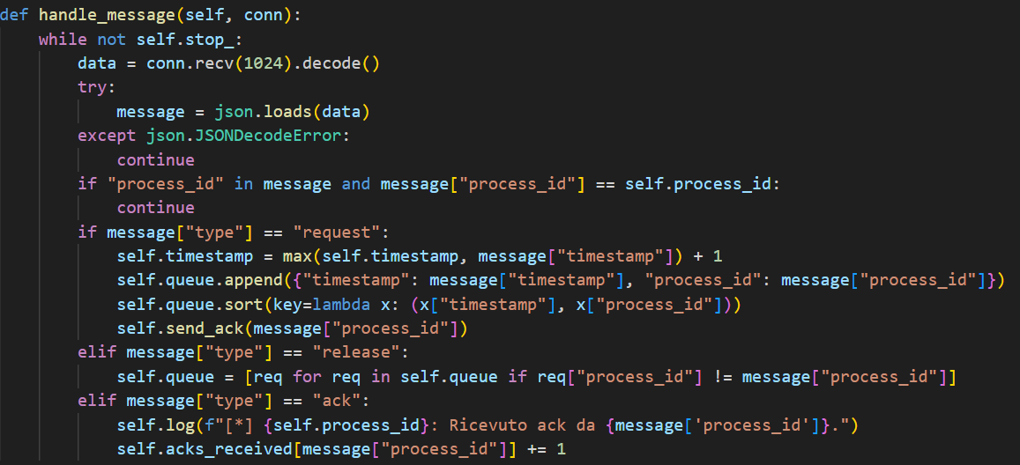
Peer-to-Peer Communication Code
Every process is implemented as a running thread. When the process is instantiated it opens a listening socket and start a thread to accept to new connections requests from other processes.
Once every process is instantiated, each one can start executing.
First thing it does is to establish the connection with every other process. Each process sends a connection request to all processes and stores the connection.
This way each process has 2*n open connections, using them in only one direction to better separate the traffic load
When a process receives a new message it first check the type of the message, which must be included and executes accordingly.

Slide 10
Event-based communication
The pub-sub paradigma still allow us to make processes communicate directly to each other, by modifying a bit what is the normal usage of the protocol (communicate events).
Here for each type of message a topic is created:
Requests topic is used for publishing requests for resources
Releases topic is used to communicate that a process releases the resource
Acks topics are used to send acks to the process that requested the resource
Every process is subscribed to the requests topic, the releases topic and only to its acks topic, which is “acks/<process_id>”

Slide 11
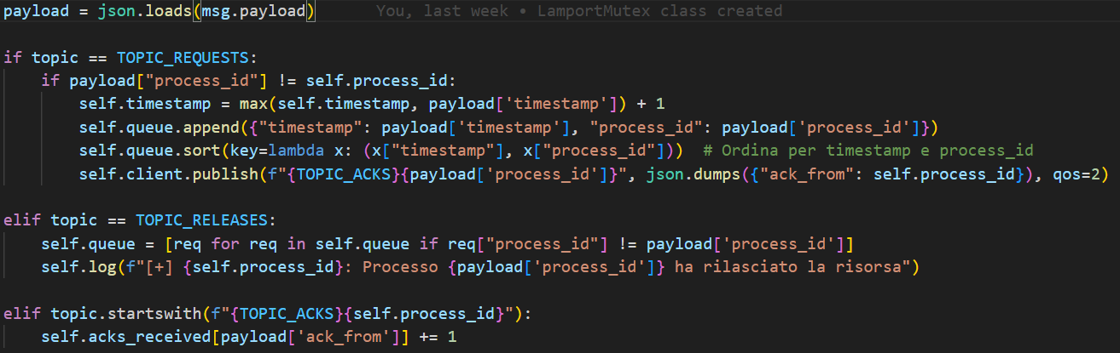
Event-based communication Code
For every message received from the broker, each process determines the originating topic and updates its variables according to the rules of Lamport's algorithm:
For each request message received the process will publish on the ack topic of the requester an {“ack_from”:process_id}
For each release message every process updates its queue according to Lamport.
For each ack received it updates oa list keeping track of all acks received

Slide 12
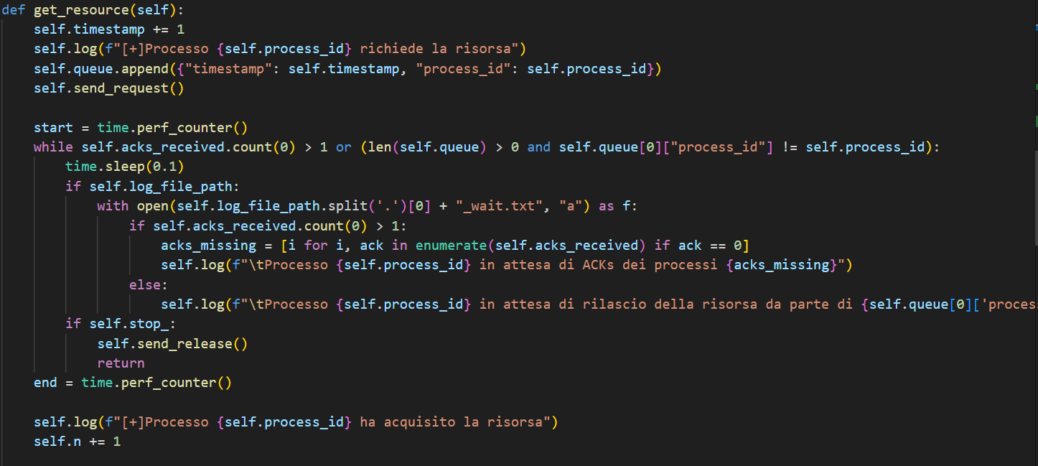
Same application logic
Waiting for acks and being first in queue

Slide 13
Comparison
As shown in the previous slide the algorithm logic can perfectly remain the same while we can modify the underlying technologies used for sending messages.
Both protocol show success in keeping the communication possible
The main differences are reported in the following table:
Feature | Sockets | MQTT
Latency | Low | Moderate(due to broker)
Scalability | Low(direct interactions) | High (broker-based)
Reliability | Low(manual error handling) | High (with Qos)

Slide 14
Socket Advantages
The implementation using socket is much lighter, only uses level 4 network protocol. There are no dependency on external brokers or middleware.
It gives us complete flexibility over communication logic and data handling.
There’s no need of a centralized role, like the broker in MQTT, to manage the communication, so no single point of failure or bottleneck.

Slide 15
MQTT Advantages
MQTT introduces some overhead in exchange for greater scalability and reliability.
What stands out the most is its ability to decouple processes from the underlying technological implementation.
Processes don’t need to know low-level details of other processes, such as their IP address or port. Communication is handled using only the process ID of each process.
Indeed the only initial part they have to do is subscribing to the topics.

Slide 16
Conclusions
Choosing the right messaging method depends on the system's needs: simplicity, scalability, or performance.
Sockets provide speed and control, making them ideal for small, tightly coupled systems.
MQTT offers reliability and flexibility, excelling in scalable and loosely coupled architectures.
Both approaches taught valuable lessons on the trade-offs in distributed system design.
The project highlights that the best solution balances technical requirements with practical implementation.

